Slide 1
Pandemic Project
Agnes
Industrial Management Department
Center for Internet of Things Innovation
National Taiwan University of Science and Technology

Slide 2
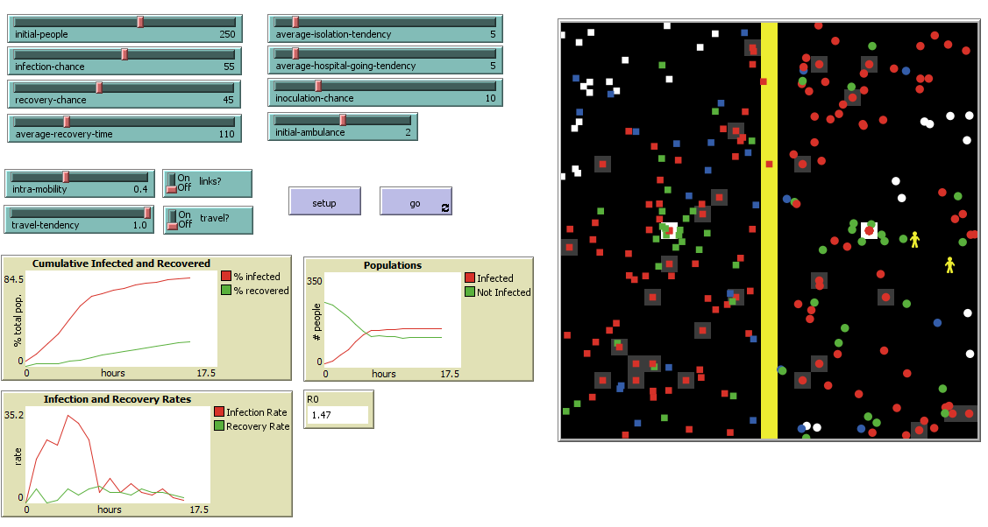


Source simulation
Uninfected individuals
Infected individuals
Recovered individuals
Received vaccine individual
Medical personnel
Isolated
Hospitalized
Notes:
Recover : who permanently immune to the virus
Medic : will send the infected individuals into the hospital when they come in contact
Intra-mobility : how fast people move / tick
Inoculate : have immune / vaccinated
--------
R_0 reflects the estimate of the reproduction number
R_0 = betaS(0)/ gamma = Nln(S(0) / S(t)) / (N - S(t))
Where:
N = total population
S(0) = initial number of susceptible
S(t) = total number of susceptible at time t
R_0 estimate the number of secondary infections that arise for an average infected individual over the course of the person’s infected period

